Slide 1
Code Volatility Project
HUAWEI TECHNOLOGIES CO. LTD (Russia)
Mr. Zorchenkov
2020-06-05

Slide 2

Content:
Self-introduction
Project idea
Volatility correlation
Volatility vs Programming languages
Volatility histogram
Project achievements
Page <number>/13

Slide 3
Self-introduction
Name: ALEXEY ZORCHENKOV
Huawei ID: z0534010
Rep. Office: Moscow City, Federation Tower 14th floor
Department : Moscow System Programming Laboratory
Position: Principal engineer
Enrollment Date: 2019-09-09
Page <number>/13

Slide 4






Experience Before Joining Huawei
Moscow State university
  Master in theoretical physics, 5.5 years
  Master in mathematics, differential equations, 5 years
  Post graduate education, theoretical mechanics, 3 years
Publications in Russian financial magazines
Page <number>/13

Slide 5

Page <number>/13

Slide 6
Previous research
Code change metrics are most reliable indicator for software defects
Code churn metric
Modified code churn metric
Metric for software programmers pairs
Change metrics don’t depend on program language
Page <number>/13

Slide 7
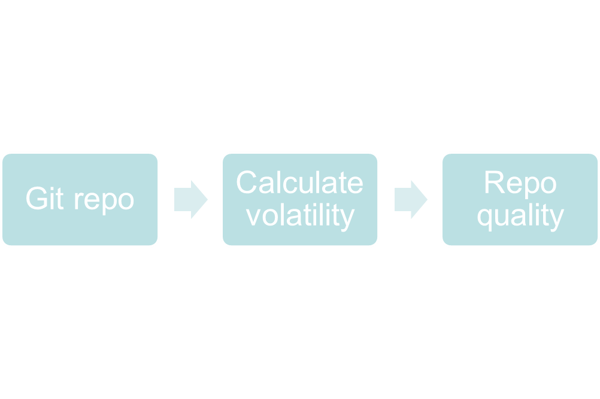
Volatility project introduction
Page <number>/13

Slide 8
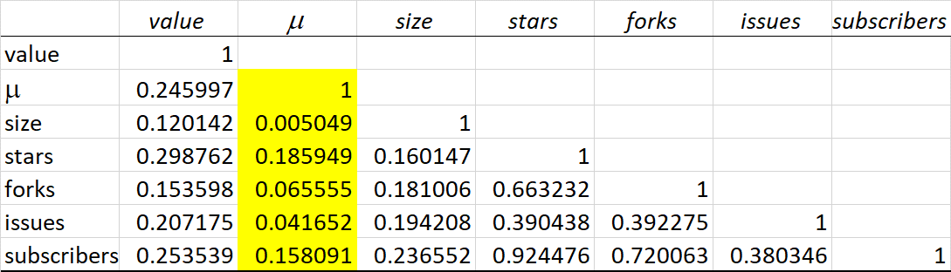
Volatility vs Other repo statistics
Page <number>/13

Slide 9
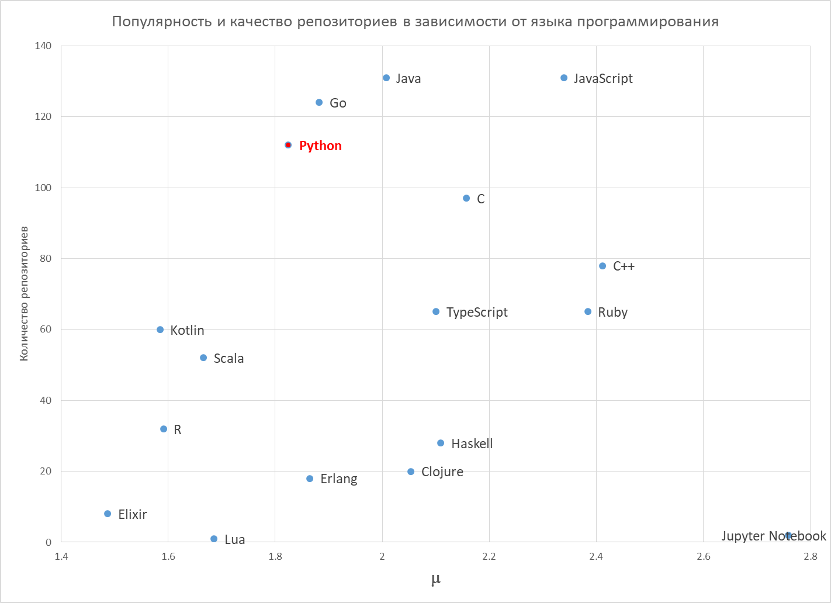
Page <number>/13

Slide 10
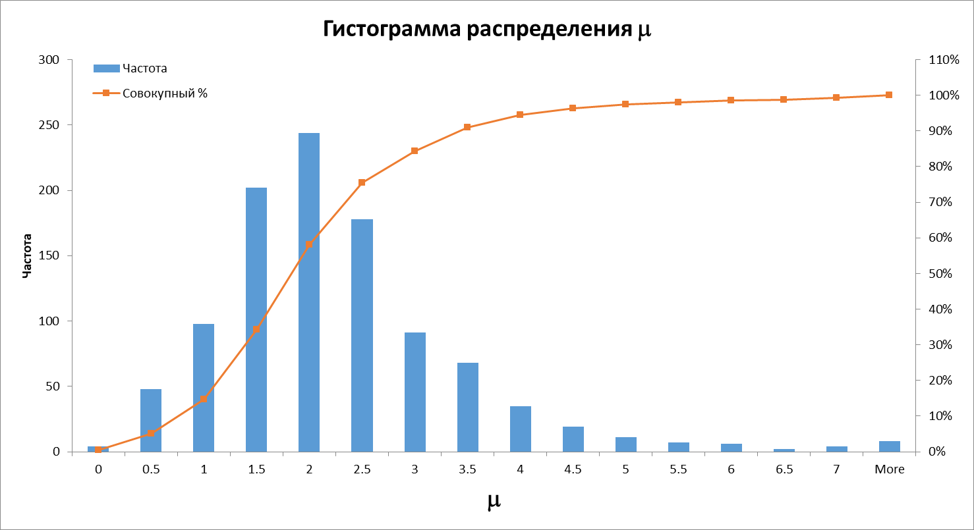
Histogram
Page <number>/13

Slide 11
Considered Git repo code quality characteristics
Characteristic | Minimum | Maximum
Duplicates | -10 | +10
Test coverage | -15 | +15
Code comments | -5 | +5
Code rules standards | -20 | +20
Page <number>/13

Slide 12
Achievements
  Researched Huawei cloud infrastructure advantages & disadvantages
  Used state of the art multiprocessing to calculate git repos statistics
  Used Git API: up to 5000 requests per day
  Found unique correlation between repo volatility and overall code quality
  Researched various git output formats to reuse in feature projects
  Distributable python package created, ready to run on Ubuntu/Windows as executable shell command (https://test.pypi.org/project/volatility-zuoqin/0.0.4/)
Page <number>/13

